Slide 1

RFID Based Bins Track & Trace Solution

Slide 2
Customer List
Kirloskar Oil Engines Limited – Kolhapur
John Deere India Pvt. Ltd.– Ranjangaon, Pune
UGC - Pune
Customer Challenges
There is no proper record of IN/OUT of Bins
User do the bins counting by manually and result accuracy is very low.
Sometimes dispatched bins are not receiving again back to source area.
Due to missed bins client has to invest on new bins because of miss handling.
The client raise complaint against received short bins and there is not any system to recheck to with dispatch Bins
Invest more time to cross identify as well as make proper dispatch.
No use life record of bins

Slide 3



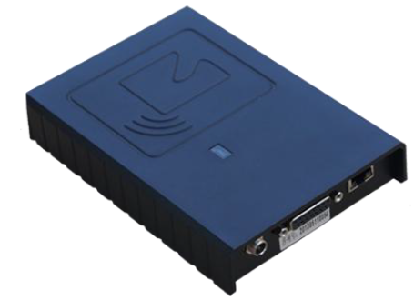
Tag Registration Process
RFID Plant Server
ERP Web Server
Using RFID application user will write on tags (Unique number).
Process:
User will request codes from ERP application .
User will get encrypted code file, decrypt the code file.
User will write the RFID tags through RFID Desktop Reader using RFID application.
Tag Registration

Slide 4
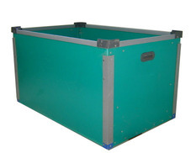
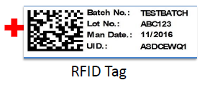
Tagging Process
Tag Fixing Mechanism
Bins
RFID Tagged Bins
User will apply manually the RFID tags on Bins

Slide 5

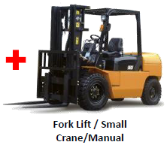
Loading Bay (Dispatch and Receiving point)
ERP Web Server
RFID Plant Server
Bins
Fork Lift / Small Crane/Manual
Fork Lift/Manual carrying RFID Tagged Bins
For Loading Bay user will pass the RFID Tagged Bins
through RFID Portal to load inside truck.

Slide 6
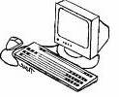
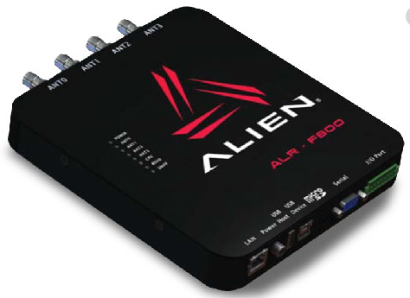
RFID Reader & Antenna with back hand method
Reader
ANT-1
ANT-3
** No. Of Antenna Depend of Length/ Width of Gate
ANT-2
ANT-4
Reader will Buffer Tag UID
Database
Reports

Slide 7
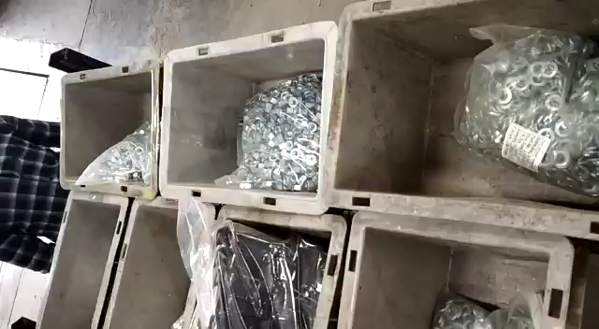
Site demo Video

Slide 8
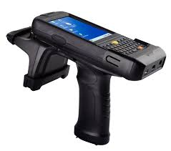

Physical Inventory of Bins at Unloading
RFID Web Server
RFID Plant Server
RFID Tagged Bins
Wired Link
The User will scan received Bins or take physical inventory through RFID handheld Reader along with Truck ID
RFID Middleware System

Slide 9
Solution Benefit
RFID systems gives proper record of IN/OUT of Bins with accurate ID
RFID System provide automatic bins record to user, NO manual user intervention.
Atomically invoice raised once dispatching bin ID received to systems at dispatching point.
The receiving point update automatically and immediately bins receive note to systems/user.
Incase of miss match bins after use our client can search using handheld or can do physical audit. So accurate missing point has been identify, end client has to bare lost bins cost
Increase dispatch accuracy, efficiency and quality.
The Systems will tell you usage of bins and scrap cycle time.

Slide 10
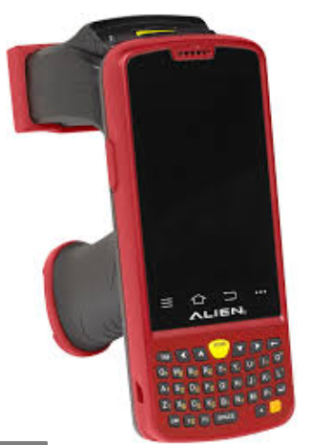
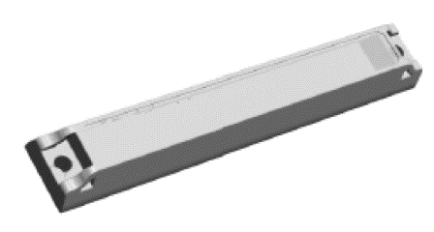
Hardware Used
RFID READER ANTEENA
RFID DESKTOP READER
RFID TERMINAL WITH 1D/2D BARCODE SCAN ENGINE
TROLLEY RFID TAGS

